Slide 1
CSE477
VLSI Digital Circuits
Fall 2002
Lecture 09: Resistance
Mary Jane Irwin ( www.cse.psu.edu/~mji ) www.cse.psu.edu/~cg477
[Adapted from Rabaey’s Digital Integrated Circuits, ©2002, J. Rabaey et al.]

Slide 2
CMOS Inverter: Dynamic
Transient, or dynamic, response determines the maximum speed at which a device can be operated.
V_{DD}
Last lecture’s focus
V_{out} = 0
C_{L}
t_{pHL} = f(R_{n}, C_{L})
R_{n}
V_{in} = V _{DD}
Today’s focus
Notes:
So propagation delay is determined by the time to charge and discharge the load capacitor CL through the on transistor chain
Today’s lecture focuses on the R term – of the transistor and the interconnect wire
Next lecture puts together what we have learned about the C term and the R term to look more closely at the dynamic inverter characteristics
Next next lecture puts them together to look at dynamic inverter characteristics

Slide 3
Review: Sources of Capacitance
V_{out}
V_{in}
V_{out2}
C_{L}
C_{G4}
M₂
M₄
C_{DB2}
C_{GD12}
V_{out}
V_{out2}
V_{in}
C_{w}
C_{DB1}
M₁
M₃
C_{G3}
intrinsic MOS transistor capacitances
extrinsic MOS transistor (fanout) capacitances
wiring (interconnect) capacitance
Notes:
Parasitic capacitances influencing the transient behavior of the cascaded inverter pair
Cgd1 and Cgd2 are the gate drain capacitances due to overlap in M1 and M2 = 2 CGD0 W
This model assumes M1 and M2 are either cut-off or in saturation (I.e., steady state)
The factor of 2 is due to the Miller effect.
Cdb1 and Cdb2 are the diffusion capacitances due to the reverse-biased pn-junction
Cw is the wiring capacitance (pp, fringe, and interwire) that depends on the length and width of the connecting wire. It is a function of the fanout of the gate and the distance to those gates.
Cg3 and Cg4 are the gate capacitances of the fanout gate that depends, primarily, on the width of those fets - includes both linear overlap and nonlinear gate capacitances

Slide 4
Review: Components of C_{L} (0.25 μm)
C Term | Expression | Value (fF) H→L | Value (fF) L→H
C_{GD1} | 2 C_{on} W_{n} | 0.23 | 0.23
C_{GD2} | 2 C_{op} W_{p} | 0.61 | 0.61
C_{DB1} | K_{eqbpn}AD_{n}C_{j} + K_{eqswn}PD_{n}C_{jsw} | 0.66 | 0.90
C_{DB2} | K_{eqbpp}AD_{p}C_{j} + K_{eqswp}PD_{p}C_{jsw} | 1.5 | 1.15
C_{G3} | (2 C_{on})W_{n} + C_{ox}W_{n}L_{n} | 0.76 | 0.76
C_{G4} | (2 C_{op})W_{p} + C_{ox}W_{p}L_{p} | 2.28 | 2.28
C_{w} | from extraction | 0.12 | 0.12
C_{L} | ∑ | 6.1 | 6.0
Notes:
Red shows values that the designer has control over!
Notice that the load capacitance is almost evenly split between its two major components: the intrinsic capacitance (green) composed of the diffusion and overlap capacitances and the extrinsic capacitance (blue) and wiring capacitances (red) contributed by the connecting gate and wire

Slide 5
Sources of Resistance
Top view
Poly Gate
Drain n+
Source n+
W
L
MOS structure resistance - R_{on}
Source and drain resistance
Contact (via) resistance
Wiring resistance

Slide 6
MOS Structure Resistance
The simplest model assumes the transistor is a switch with an infinite “off” resistance and a finite “on” resistance R_{on}
However R_{on} is nonlinear, so use instead the average value of the resistances, R_{eq}, at the end-points of the transition (V_{DD} and V_{DD}/2)
R_{eq} = ½ (R_{on}(t₁) + R_{on}(t₂))
R_{eq} = ¾ V_{DD}/I_{DSAT} (1 – 5/6 λ V_{DD})
V_{GS} ≥ V_{T}
R_{on}
S
D
Notes:
Main problem is that Ron of the transistor is time variant, non-linear and depends on the operating point of the transistor
lambda is an empirical parameter – channel-length modulation – varies roughly with the inverse of the channel length

Slide 7
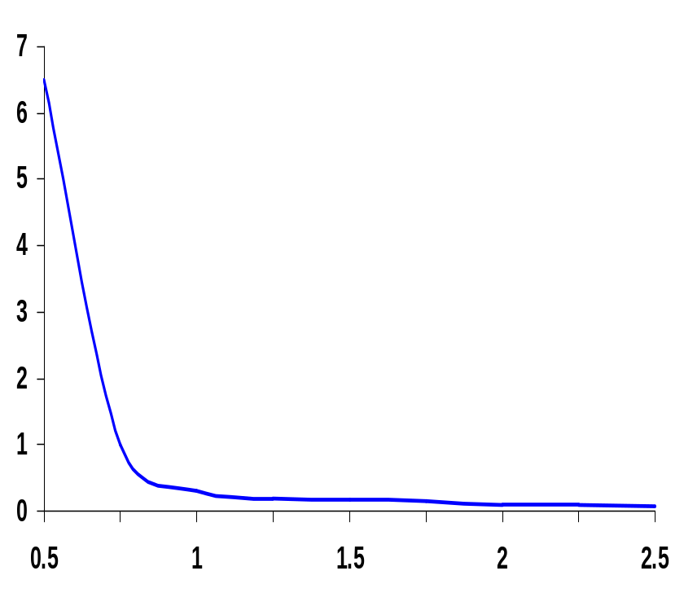
Equivalent MOS Structure Resistance
The on resistance is inversely proportional to W/L. Doubling W halves R_{eq}
x10⁵
(for V_{GS} = V_{DD},
V_{DS} = V_{DD}→V_{DD}/2)
For V_{DD}>>V_{T}+V_{DSAT}/2, R_{eq} is independent of V_{DD} (see plot). Only a minor improvement in R_{eq} occurs when V_{DD} is increased (due to channel length modulation)
Once the supply voltage approaches V_{T}, R_{eq} increases dramatically
R_{eq} (Ohm)
V_{DD} (V)
V_{DD}(V) | 1 | 1.5 | 2 | 2.5
NMOS(kΩ) | 35 | 19 | 15 | 13
PMOS (kΩ) | 115 | 55 | 38 | 31
R_{eq} (for W/L = 1), for larger devices divide R_{eq} by W/L
Notes:
Model as a switch with an infinite off-resistance and a finite on-resistance
Unfortunately, Ron is time-variant, non-linear and depends on the operating point
Table gives equivalent resistance Req (W/L =1) in 0.25 micron CMOS process (with L = Lmin).
For larger devices, divide Req by W/L = doubling the transistor width halves the resistance

Slide 8
Source and Drain Resistance
G
D
S
R_{S}
R_{D}
R_{S,D} = (L_{S,D}/W)R
where L_{S,D} is the length of the source or drain diffusion
R is the sheet resistance of the source or drain
diffusion (20 to 100 Ω/)
More pronounced with scaling since junctions are shallower
With silicidation R is reduced to the range 1 to 4 Ω/
Notes:
Resistance of a square of material is constant, independent of its size
The series resistance causes a deterioration in the device performance as it reduces the drain current for a given control voltage.
The effect becomes more pronounced when transistors are scaled down because of shallower junctions and smaller contact openings.
How to keep it small –
Silicidation – cover the drain and source regions with low-resistivity material (titanium or tungsten) – silicidation - effectively reduces the sheet resistance to values in the range from 1 to 4 ohms/square.
Making the transistor wider will help too.
with silicidation and proper attention to layout – parasitic resistance is not important.

Slide 9
Contact Resistance
Transitions between routing layers (contacts through via’s) add extra resistance to a wire
  keep signals wires on a single layer whenever possible
  avoid excess contacts
  reduce contact resistance by making vias larger (beware of current crowding that puts a practical limit on the size of vias) or by using multiple minimum-size vias to make the contact
Typical contact resistances, R_{C}, (minimum-size)
  5 to 20 Ω for metal or poly to n+, p+ diffusion and metal to poly
  1 to 5 Ω for metal to metal contacts
More pronounced with scaling since contact openings are smaller
Notes:
Current crowding – current tends to concentrate around the perimeter in larger contacts
So its better to use several smaller contact cuts side-by-side than one big contact cut (as done by max)

Slide 10
Wire Resistance
ρ L
ρ L
R =
=
A
H W
Sheet Resistance R
L
R₁
=
R₂
H
=
W
Material | Sheet Res. (Ω/)
n, p well diffusion | 1000 to 1500
n+, p+ diffusion | 50 to 150
n+, p+ diffusion with silicide | 3 to 5
polysilicon | 150 to 200
polysilicon with silicide | 4 to 5
Aluminum | 0.05 to 0.1
Material | ρ(Ω-m)
Silver (Ag) | 1.6 x 10⁻⁸
Copper (Cu) | 1.7 x 10⁻⁸
Gold (Au) | 2.2 x 10⁻⁸
Aluminum (Al) | 2.7 x 10⁻⁸
Tungsten (W) | 5.5 x 10⁻⁸
Notes:
Resistance in ohms; sheet resistance is in ohms per square
rho is the resistivity of the material
Aluminum used due to low cost and compatibility with fab process; Top of the line processes (e.g., IBM) are now increasingly using Copper as the conductor of choice

Slide 11
Skin Effect
At high frequency, currents tend to flow primarily on the surface of a conductor with the current density falling off exponentially with depth into the wire
W
= √(ρ/(πfμ))
where f is frequency
μ = 4π x 10⁻⁷ H/m
so the overall cross section is ~ 2(W+H)δ
= 2.6 μm
for Al at 1 GHz
H
The onset of skin effect is at f_{s} - where the skin depth is equal to half the largest dimension of the wire.
f_{s} = 4 ρ / (π μ (max(W,H))²)
An issue for high frequency, wide (tall) wires (i.e., clocks!)
Notes:
mhu is the permeability of the surrounding dielectric
e.g., H = 10 and W = 20, not 200, but 2(10+20)2.8 = 168
below fs, the whole wire is conducting current
isn’t it the smallest dimension of the wire?
Ask as question - Largest dimension of a Al wire at 1GHz is 5.2 μm

Slide 12
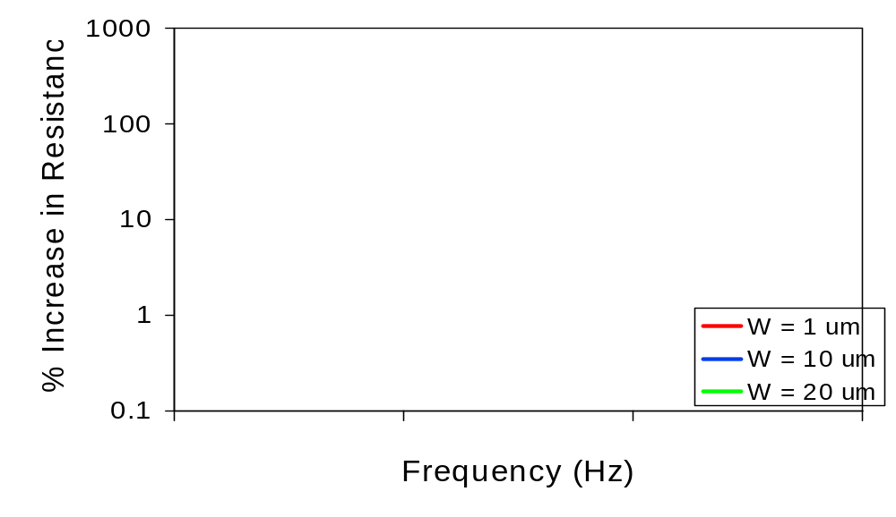
Skin Effect for Different W’s
for H = .70 um
1E8
1E9
1E10
A 30% increase in resistance is observe for 20 μm Al wires at 1 GHz (versus only a 1% increase for 1 μm wires)
Notes:
Another design concern is that copper may move the onset of skin effects to lower frequencies (rho is in the numerator of the determining equation)

Slide 13

The Wire
transmitters
receivers
schematic
physical

Slide 14
Wire Models
Interconnect parasitics (capacitance, resistance, and inductance)
  reduce reliability
  affect performance and power consumption
All-inclusive (C,R,l) model
Capacitance-only
Notes:
This is for the wiring plan on the previous slide!

Slide 15
Parasitic Simplifications
Inductive effects can be ignored
  if the resistance of the wire is substantial enough (as is the case for long Al wires with small cross section)
  if the rise and fall times of the applied signals are slow enough
When the wire is short, or the cross-section is large, or the interconnect material has low resistivity, a capacitance only model can be used
When the separation between neighboring wires is large, or when the wires run together for only a short distance, interwire capacitance can be ignored and all the parasitic capacitance can be modeled as capacitance to ground

Slide 16
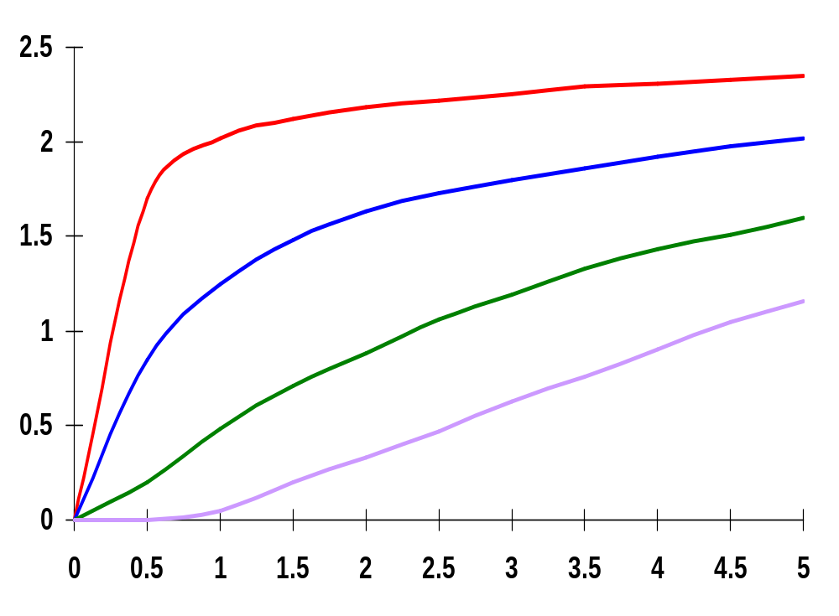
Simulated Wire Delays
L
V_{in}
V_{out}
L/10
L/4
L/2
L
voltage (V)
time (nsec)
Notes:
plots the waveforms at different points in the wire as a function of time (and space), what is L? (cm length?)
Observe how the step waveform “diffuses” from the start to the end of the wire and that the waveform rapidly degrades, resulting in considerable delay for long wires

Slide 17
Wire Delay Models
Ideal wire
  same voltage is present at every segment of the wire at every point in time - at equi-potential
  only holds for very short wires, i.e., interconnects between very nearest neighbor gates
Lumped C model
  when only a single parasitic component (C, R, or L) is dominant the different fractions are lumped into a single circuit element
    When the resistive component is small and the switching frequency is low to medium, can consider only C; the wire itself does not introduce any delay; the only impact on performance comes from wire capacitance
Driver
V_{out}
R_{Driver}
V_{out}
c_{wire}
C_{lumped}
capacitance per unit length
  good for short wires; pessimistic and inaccurate for long wires
Notes:
Model of choice for the analysis of most interconnect wires
However, wires over a few mm length have a significant resistance, so have to use the distributed (or lumped) RC model

Slide 18
Wire Delay Models, con’t
Lumped RC model
  total wire resistance is lumped into a single R and total capacitance into a single C
  good for short wires; pessimistic and inaccurate for long wires
Distributed RC model
  circuit parasitics are distributed along the length, L, of the wire
    c and r are the capacitance and resistance per unit length
rΔL
rΔL
rΔL
rΔL
rΔL
(r,c,L)
V_{in}
V_{N}
V_{in}
V_{N}
cΔL
cΔL
cΔL
cΔL
cΔL
  Delay is determined using the Elmore delay equation
τ_{Di} = ∑ c_{k}r_{ik}
N
k=1
Notes:
Lumped model is, once again, only good for short wires – and give pessimistic results
Elmore delay is the equivalent to the first-order time constant of the network (a simple approx. of the actual delay between input node and node i)

Slide 19
RC Tree Definitions
RC tree characteristics
  A unique resistive path exists between the source node and any node of the network
    Single input (source) node, s
    All capacitors are between a node and GND
    No resistive loops
2
r₂
r₁
c₂
s
1
r₃
r₄
4
c₁
c₄
3
r_{i}
c₃
i
  Path resistance (sum of the resistances on the path from the input node to node i)
r_{ii} = ∑ r_{j} ⇒ (r_{j} ∈ [path(s → i)]
c_{i}
i
j=1
  Shared path resistance (resistance shared along the paths from the input node to nodes i and k)
r_{ik} = ∑ r_{j} ⇒ (r_{j} ∈ [path(s → i) ∩ path(s → k)])
N
j=1
A typical wire is a chain network with (simplified) Elmore delay of
τ_{DN} = ∑ c_{i}r_{ii}
N
i=1
Notes:
Path resistance – Rii (from the input node to any node i of the network); e.g., R44 = R1 + R3 + R4
Shared path resistance – resistances shared along paths
Ask class - Ri4 = R1 + R3 (the resistors that are shared on all paths that go through 1 and 3 along the way) and Ri2 = R1
Ask class – what is the Elmore delay equation for node i of the RC tree?
tDi = R1C1 + R1C2 + (R1 + R3)C3 + (R1 + R3) C4 + (R1 + R3 + Ri) Ci
Once again, only good for short wires – and give pessimistic results

Slide 20
Chain Network Elmore Delay
r₁
r₂
r_{i-1}
r_{i}
r_{N}
1
2
i-1
i
N
V_{in}
V_{N}
c₁
c₂
c_{i-1}
c_{i}
c_{N}
N
i
Elmore delay equation τ_{DN} = ∑ c_{i}r_{ii} = ∑ c_{i} ∑ r_{j}
Notes:
For class handout

Slide 21
Chain Network Elmore Delay
τ_{D1}=c₁r₁
τ_{D2}=c₁r₁ + c₂(r₁+r₂)
r₁
r₂
r_{i-1}
r_{i}
r_{N}
1
2
i-1
i
N
V_{in}
V_{N}
c₁
c₂
c_{i-1}
c_{i}
c_{N}
τ_{Di}=c₁r₁+ c₂(r₁+r₂)+…+c_{i}(r₁+r₂+…+r_{i})
N
i
Elmore delay equation τ_{DN} = ∑ c_{i}r_{ii} = ∑ c_{i} ∑ r_{j}
τ_{Di}=c₁r_{eq}+ 2c₂r_{eq}+ 3c₃r_{eq}+…+ ic_{i}r_{eq}
Notes:
For lecture
Why is chain model important – because its what most resistive-capacitive wires look like in a digital circuit (encountered most often)
Note - the shared-path resistance is replaced by the path resistance!
If all Resistances are equal size can replace R values by Req

Slide 22
Elmore Delay Models Uses
Modeling the delay of a wire
Modeling the delay of a series of pass transistors
Modeling the delay of a pull-up and pull-down networks

Slide 23
Distributed RC Model for Simple Wires
A length L RC wire can be modeled by N segments of length L/N
  The resistance and capacitance of each segment are given by r L/N and c L/N
τ_{DN} = (L/N)²(cr+2cr+…+Ncr) = (crL²) (N(N+1))/(2N²) = CR((N+1)/(2N))
  where R (= rL) and C (= cL) are the total lumped resistance and capacitance of the wire
For large N τ_{DN} = RC/2 = rcL²/2
  Delay of a wire is a quadratic function of its length, L
  The delay is 1/2 of that predicted (by the lumped model)
Notes:
Use Elmore formula to compute the dominant time-constant of the wire – tau DN
r and c are the resistance and capacitance per unit length
R and C are the total lumped resistance and capacitance of the wire
Doubling the length of a wire quadruples its delay
Confirms that the lumped model presents a pessimistic view of the wire delay - use N=1 in above formula
Lump total wire resistance of each wire segment into one single R – lumped RC model – is pessimistic and inaccurate for long interconnect wires, so …

Slide 24
Step Response Points
Voltage Range | Lumped RC | Distributed RC
0 → 50% (t_{p}) | 0.69 RC | 0.38 RC
0 → 63% (τ) | RC | 0.5 RC
10% → 90% (t_{r}) | 2.2 RC | 0.9 RC
0 → 90% | 2.3 RC | 1.0 RC
Time to reach the 50% point is t = ln(2)τ = 0.69τ
Time to reach the 90% point is t = ln(9)τ = 2.2τ
Example: Consider a Al1 wire 10 cm long and 1 μm wide
  Using a lumped C only model with a source resistance (R_{Driver}) of 10 kΩ and a total lumped capacitance (C_{lumped}) of 11 pF
  t_{50%} = 0.69 x 10 kΩ x 11pF = 76 ns
  t_{90%} = 2.2 x 10 kΩ x 11pF = 242 ns
  Using a distributed RC model with c = 110 aF/μm and r = 0.075 Ω/μm
  t_{50%} = 0.38 x (0.075 Ω/μm) x (110 aF/μm) x (10⁵ μm)² = 31.4 ns
  t_{90%} = 0.9 x (0.075 Ω/μm) x (110 aF/μm) x (10⁵ μm)² = 74.25 ns
Poly: t_{50%} = 0.38 x (150 Ω/μm) x (88+2×54 aF/μm) x (10⁵ μm)² = 112 μs
Al5: t_{50%} = 0.38 x (0.0375 Ω/μm) x (5.2+2×12 aF/μm) x (10⁵ μm)² = 4.2 ns
Notes:
Needs to solve a set of partial differential equations
Note that step response points for the distributed RC model are half that of the lumped.
The delay introduced by the wire resistance becomes dominate when (RwCs)/2 >= RDriverCw or L >= 2 Rdriver/r
Assume a driver with a source resistance of 1 kohm, driving an Al1 wire of 1 micron wide (r = 0.075 ohm/micron) leads to a critical length of 2.67 cm

Slide 25
Putting It All Together
R_{Driver}
r_{w},c_{w},L
V_{out}
V_{in}
Total propagation delay consider driver and wire
τ_{D} = R_{Driver}C_{w} + (R_{w}C_{w})/2 = R_{Driver}C_{w} + 0.5r_{w}c_{w}L²
and t_{p} = 0.69 R_{Driver}C_{w} + 0.38 R_{w}C_{w}
where R_{w} = r_{w}L and C_{w} = c_{w}L
The delay introduced by wire resistance becomes dominant when (R_{w}C_{w})/2 ≥ R_{Driver} C_{W} (when L ≥ 2R_{Driver}/R_{w})
  For an R_{Driver} = 1 kΩ driving an 1 μm wide Al1 wire, L_{crit} is 2.67 cm

Slide 26
Design Rules of Thumb
rc delays should be considered when t_{pRC} > t_{pgate} of the driving gate
  L_{crit} > √ (t_{pgate}/0.38rc)
  actual L_{crit} depends upon the size of the driving gate and the interconnect material
rc delays should be considered when the rise (fall) time at the line input is smaller than RC, the rise (fall) time of the line
  t_{rise} < RC
  when not met, the change in the signal is slower than the propagation delay of the wire so a lumped C model suffices

Slide 27
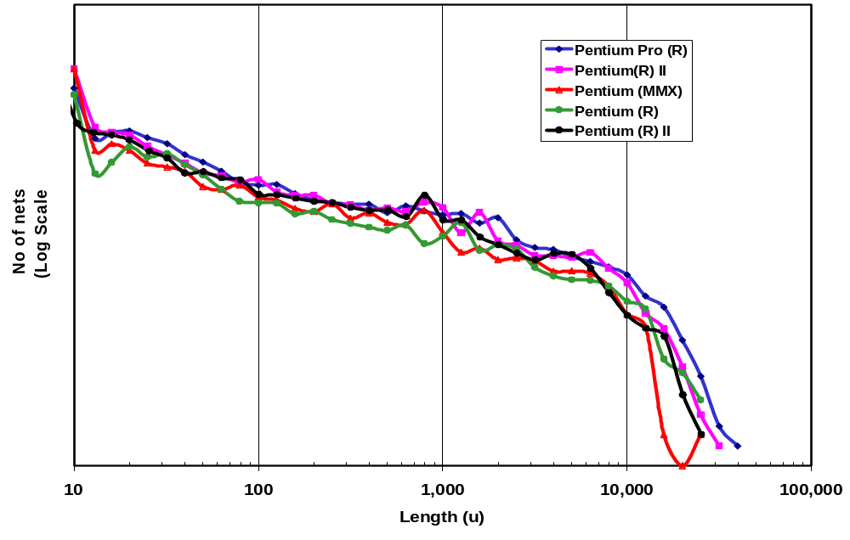

Nature of Interconnect
Global Interconnect
Source: Intel
Notes:
1,000 microns = 1 cm ?right?

Slide 28
Overcoming Interconnect Resistance
Selective technology scaling
  scale W while holding H constant
Use better interconnect materials
  lower resistivity materials like copper
    As processes shrink, wires get shorter (reducing C) but they get closer together (increasing C) and narrower (increasing R). So RC wire delay increases and capacitive coupling gets worse.
    Copper has about 40% lower resistivity than aluminum, so copper wires can be thinner (reducing C) without increasing R
  use silicides (WSi₂, TiSi₂, PtSi₂ and TaSi)
    Conductivity is 8-10 times better than poly alone
silicide
polysilicon
SiO₂
+
+
n
n
p
Use more interconnect layers
  reduces the average wire length L (but beware of extra contacts)
Notes:
A silicide is a compound material formed using silicon and a refractory metal to create a highly conductive material that can withstand high-temperature process steps without melting.
WSi2 has a resistitivity of 130 microohms-cm
Similar techniques are used to reduce the source and drain resistance of the transistor

Slide 29
Wire Spacing Comparisons
Intel P858
Al, 0.18μm
Intel P856.5
Al, 0.25μm
IBM CMOS-8S
CU, 0.18μm
Ω - 0.07 M6
Ω - 0.05 M5
Ω - 0.10 M7
Ω - 0.08 M5
Ω - 0.10 M6
Ω - 0.12 M4
Ω - 0.17 M4
Ω - 0.50 M5
Ω - 0.33 M3
Ω - 0.49 M3
Ω - 0.50 M4
Ω - 0.50 M3
Ω - 0.33 M2
Ω - 0.49 M2
Ω - 0.70 M2
Ω - 1.11 M1
Ω - 1.00 M1
Ω - 0.97 M1
Scale: 2,160 nm
From MPR, 2000
Notes:
From the Intel generations, its clear that the wires get closer together, but the vertical dimensions do not shrink proportionally, which increases capacitance.
In contrast, IBM’s copper interconnect has much thinner layers – thus less capacitance – even though the wire resistance (including cladding) is similar to that of the P858 technology

Slide 30
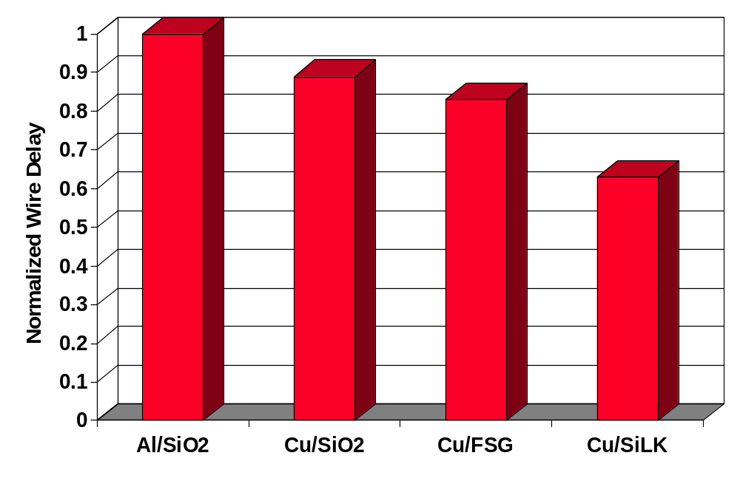
Comparison of Wire Delays
From MPR, 2000
Notes:
Relative speed of a 200-micron M3 interconnect wire for four metal/dielectric systems. All three copper wires were the same thickness and the aluminum wire was scaled to the same sheet resistance.

Slide 31
Inductance
When the rise and fall times of the signal become comparable to the time of flight of the signal waveform across the line, then the inductance of the wire starts to dominate the delay behavior
Must consider wire transmission line effects
  Signal propagates over the wire as a wave (rather than diffusing as in rc only models)
    Signal propagates by alternately transferring energy from capacitive to inductive modes
l
l
l
l
r
r
r
r
V_{in}
V_{out}
g
c
g
c
g
c
g
c
Notes:
Condition holds when the switching speed is sufficiently fast, the quality of the interconnect material is high enough that the resistance of the wire is kept within bounds.
In transmission line - signal propagates as a wave (in the RC model we assume the signal diffuses from the source to destination). In a signal wave the signal propagates by transferring energy from capacitive to inductive nodes.
Effects speed and ringing – when wave is reflected back on itself. To avoid wave reflection of signal must terminate wire correctly (a matched termination, avoid open and short circuit terminations)

Slide 32
More Design Rules of Thumb
Transmission line effects should be considered when the rise or fall time of the input signal (t_{r}, t_{f}) is smaller than the time-of-flight of the transmission line (t_{flight})
t_{r} (t_{f}) < 2.5 t_{flight} = 2.5 L/v
  For on-chip wires with a maximum length of 1 cm, we only worry about transmission line effects when t_{r} < 150 ps
Transmission line effects should only be considered when the total resistance of the wire is limited
R < 5 Z₀ = 5 (V/I)
Notes:
V is the velocity (speed)
Z0 is the impedance – characteristic impedance of the wire is a function of the dielectric medium and the geometry of the conducting wire and isolator (is independent of the length of the wire and the frequency of its signal). Typical values of characteristic impedances of wires in semiconductor circuits is from 10 to 200 ohms.

Slide 33
Next Lecture and Reminders
Next lecture
  The CMOS inverter dynamic view
    Reading assignment – Rabaey, et al, 5.4.2-5.4.3
Reminders
  Project specifications due next lecture (October 3rd )
  HW3 due Oct 10th (hand in to TA)
  Class cancelled on Oct 10th as make up for evening midterm
  I will be out of town Oct 10th through Oct 15th and Oct 18th through Oct 23rd, so office hours during those periods are cancelled
  Evening midterm exam scheduled
    Wednesday, October 16th from 8:15 to 10:15pm in 260 Willard
    Only one midterm conflict filed for so far

